Slide 1

PROJECT PRESENTATION
Parking Management System
A Robust Native x64 Assembly Solution for Modern Infrastructure
Presenated By:
Rana Haseeb Shahzad 42887
Ahmad Bin Qasim 42841

Slide 2

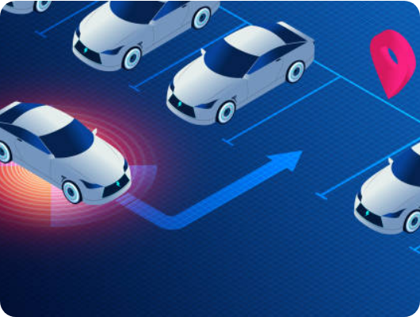

What is this Project?
Helping People Park
We built a simple app to track cars in a parking lot. It’s like a digital notebook for a parking guard.
Space: It holds exactly 8 vehicles.
Types: It tracks Rickshaws, Cars, and Buses.

Slide 3






How to Use It
Press a Key
See Info
Reset
Just press 1, 2, or 3 to add a vehicle instantly.
Press 4 to see how much money we made.
Press 5 to delete everything and start fresh.

Slide 4

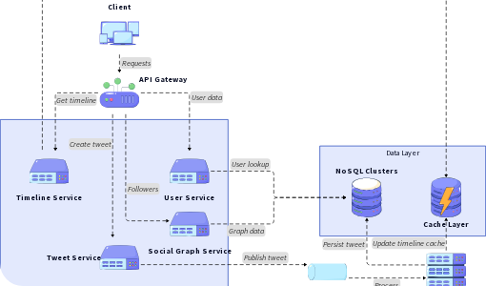
The Computer's Notepad
Registers (Quick Notes)
Computers have "Registers." Think of them as Post-it notes for the brain.
We use RAX to count the money and RCX to show text on the screen.

Slide 5



How the Code Thinks
Decisions (CMP & JE): The code "Compares" your key press. If you press '1', it "Jumps" to the Rickshaw part.
Shadow Space: We "book" a small 32-byte area in memory. It’s like a workspace for the code to stay organized.
Full Check: Before adding a car, the code checks: "Is it 8 yet?" If yes, it stops you from adding more.

Slide 6
The Price List
Vehicle Type | Cost to Park
Rickshaw | 200 Units
Car | 300 Units
Bus | 400 Units
Total Money | Calculated Instantly

Slide 7
What we Achieved
Fast
8
Easy
Very quick code
Max Spaces
To use & reset
In the future, we can add a way to save this data to a file permanently.

Slide 8
Questions?
Thanks for listening to our presentation!
Built with x64 Assembly Language

